Slide 1
Force that influence climate most in your region and why ?
Here is where your presentation begins

Slide 3
Force that influence climate your region and why ?
Regions:-
Goa
Daman and Diu
Telangana
Critical analysis of the problem and its cause in detail
Current effects of the problem on the ecosystem, growth rate
What would be the state if it continues to grow at the existing rate?
Possible solutions, expected time frame to bring the problem under control
Case study
Whether the knowledge gained through this preparation created any impact on you
Conclusion

Slide 4
CONTENTS OF THIS TEMPLATE
Here’s what you’ll find in this Slidesgo template:
A slide structure based on a multi-purpose presentation for education, which you can easily adapt to your needs. For more info on how to edit the template, please visit Slidesgo School or read our FAQs.
To view this template in PPT with the correct fonts, download and install on your computer the fonts that we have used. You can learn how to download and install fonts here.
An assortment of graphic resources that are suitable for use in the presentation can be found in the alternative resources slide.
A thanks slide, which you must keep so that proper credits for our design are given.
A resources slide, where you’ll find links to all the elements used in the template.
Instructions for use.
Final slides with:
The fonts and colors used in the template.
A selection of illustrations. You can also customize and animate them as you wish with the online editor. Visit Storyset to find more.
More infographic resources, whose size and color can be edited.
Sets of customizable icons of the following themes: general, business, avatar, creative process, education, help & support, medical, nature, performing arts, SEO & marketing, and teamwork.
You can delete this slide when you’re done editing the presentation.

Slide 5
TABLE OF CONTENTS
01
02
03
HISTORY
WEATHER
CLIMATE
04
05
06
WATER
ACTIVITIES
OUR TEAM
You can describe the topic of the section here
You can describe the topic of the section here
You can describe the topic of the section here
You can describe the topic of the section here
You can describe the topic of the section here
You can describe the topic of the section here

Slide 6
23rd March
On March 23rd, World Meteorological Day (WWD) is celebrated to commemorate the entry into force, in 1950, of the Convention establishing the World Meteorological Organization

Slide 7

THE SLIDE TITLE GOES HERE!
Do you know what helps you make your point clear?
Lists like this one:
They’re simple
You can organize your ideas clearly
You’ll never forget to buy milk!
And the most important thing: the audience won’t miss the point of your presentation

Slide 8
01
HISTORY
You can enter a subtitle here if you need it

Slide 9
INTRODUCTION
You can give a brief description of the topic you want to talk about here. For example, if you want to talk about Mercury, you can say that it’s the smallest planet in the entire Solar System

Slide 10
—SOMEONE FAMOUS
“This is a quote, words full of wisdom that someone important said and can make the reader get inspired.”

Slide 11
OUR SERVICES
METEOROLOGICAL
HYDROLOGICAL
Mercury is the closest planet to the Sun and the smallest one in the Solar System—it’s only a bit larger than the Moon
Venus has a beautiful name and is the second planet from the Sun. It’s hot and has a poisonous atmosphere

Slide 12
02
WEATHER
You can enter a subtitle here if you need it

Slide 13
WORLD MANIFEST
WEATHER
CLIMATE
WATER
Mercury is the closest planet to the Sun and the smallest one
Venus has a beautiful name and is the second planet from the Sun
Despite being red, Mars is actually a cold place. It’s full of iron oxide dust

Slide 14

COLLABORATE WITH THE CLIMATE
I MUST DO
NOT TO DO
Venus is the second planet from the Sun
Jupiter is the biggest planet in the Solar System
Despite being red, Mars is a cold place
Saturn is a gas giant and has several rings
Earth is the third planet from the Sun
Neptune is the farthest planet from the Sun
Uranus is the seventh planet from the Sun
Mercury is the closest planet to the Sun

Slide 15
OUR SERVICES
METEOROLOGICAL
HYDROLOGICAL
SAFETY
WELFARE
Mercury is the closest planet to the Sun and the smallest one
Venus has a beautiful name and is the second planet from the Sun
Jupiter is the biggest planet of them all
Saturn is a gas giant and has several rings

Slide 16
WEATHER JOURNAL
SUNNY
CLOUDY
RAINY
FOGGY
WINDY
STORMY
Mercury is the closest planet to the Sun
Venus is the second planet from the Sun
Mars is actually a very cold place
Jupiter is the biggest planet of them all
Saturn is composed of hydrogen and helium
Neptune is the farthest planet from the Sun

Slide 17
03
CLIMATE
You can enter a subtitle here if you need it

Slide 18
150,000
Big numbers catch your audience’s attention

Slide 19
WEATHER TABLE
PERIOD | JAN | FEB | MAR | APR | MAY | JUN | JUL | AUG | SEP | OCT | NOV | DEC | YEAR
2018 | 45 | 22 | 20 | 12 | 43 | 55 | 50 | 11 | 65 | 50 | 45 | 88 | 100
2017 | 50 | 88 | 10 | 33 | 28 | 25 | 28 | 54 | 50 | 11 | 10 | 22 | 91
2016 | 60 | 50 | 90 | 50 | 98 | 22 | 98 | 14 | 28 | 45 | 28 | 45 | 96
2015 | 20 | 28 | 74 | 28 | 75 | 28 | 33 | 75 | 50 | 32 | 66 | 28 | 100
MERCURY
VENUS
MARS
RAINY
It’s the closest planet to the Sun
Venus is the second planet from the Sun
Mars is actually a very cold place
Earth is the third planet from the Sun

Slide 20
9h 55m 23s
333,000.00
386,000 km
Jupiter's rotation period
The Sun’s mass compared to Earth’s
Distance between Earth and the Moon

Slide 21
METEOROLOGICAL INFOGRAPHIC
GRAY
CLOUDY
Mercury is a small planet
Saturn is a gas giant with rings
HOT
SUNNY
WORLD
Venus has a beautiful name
Mars is actually a very cold place
Pluto is considered a dwarf planet
FOGGY
SNOWY
Jupiter is the biggest planet
Neptune is far from the Sun

Slide 22
04
WATER
You can enter a subtitle here if you need it

Slide 23
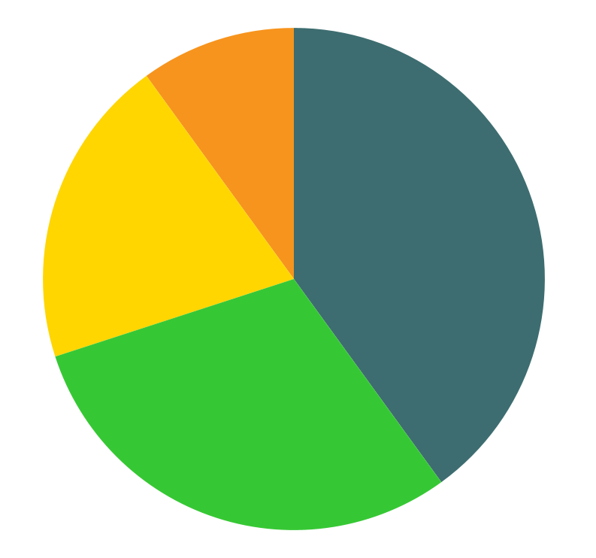
THIS IS A GRAPH
VENUS
40%
Venus is the second planet from the Sun
MERCURY
30%
It’s the closest planet to the Sun
SATURN
20%
It’s composed of hydrogen and helium
JUPITER
10%
Jupiter is the biggest planet of them all
Follow the link in the graph to modify its data and then paste the new one here. For more info, click here

Slide 24
WORLD TEMPERATURES (ºC)
SATURN
VENUS
It’s composed of hydrogen and helium
Venus is the second planet from the Sun
10º
34º
20º
30º
JUPITER
MERCURY
Jupiter is the biggest planet of them all
It’s the closest planet to the Sun

Slide 25
METEOROLOGICAL PERCENTAGES
SUNNY
80%
Mercury is the closest planet to the Sun
RAINY
60%
Mars is actually a very cold place
CLOUDY
40%
Venus is the second planet from the Sun

Slide 26
WHAT’S THE WEATHER LIKE?
SNOWY | STORMY | RAINY | HOT AND HUMID
SUNNY | WINDY | CLOUDY | FOGGY
1.It’s…
2.It’s…
3.It’s…
4.It’s…
5.It’s…
6.It’s…
7.It’s…
8.It’s…

Slide 27
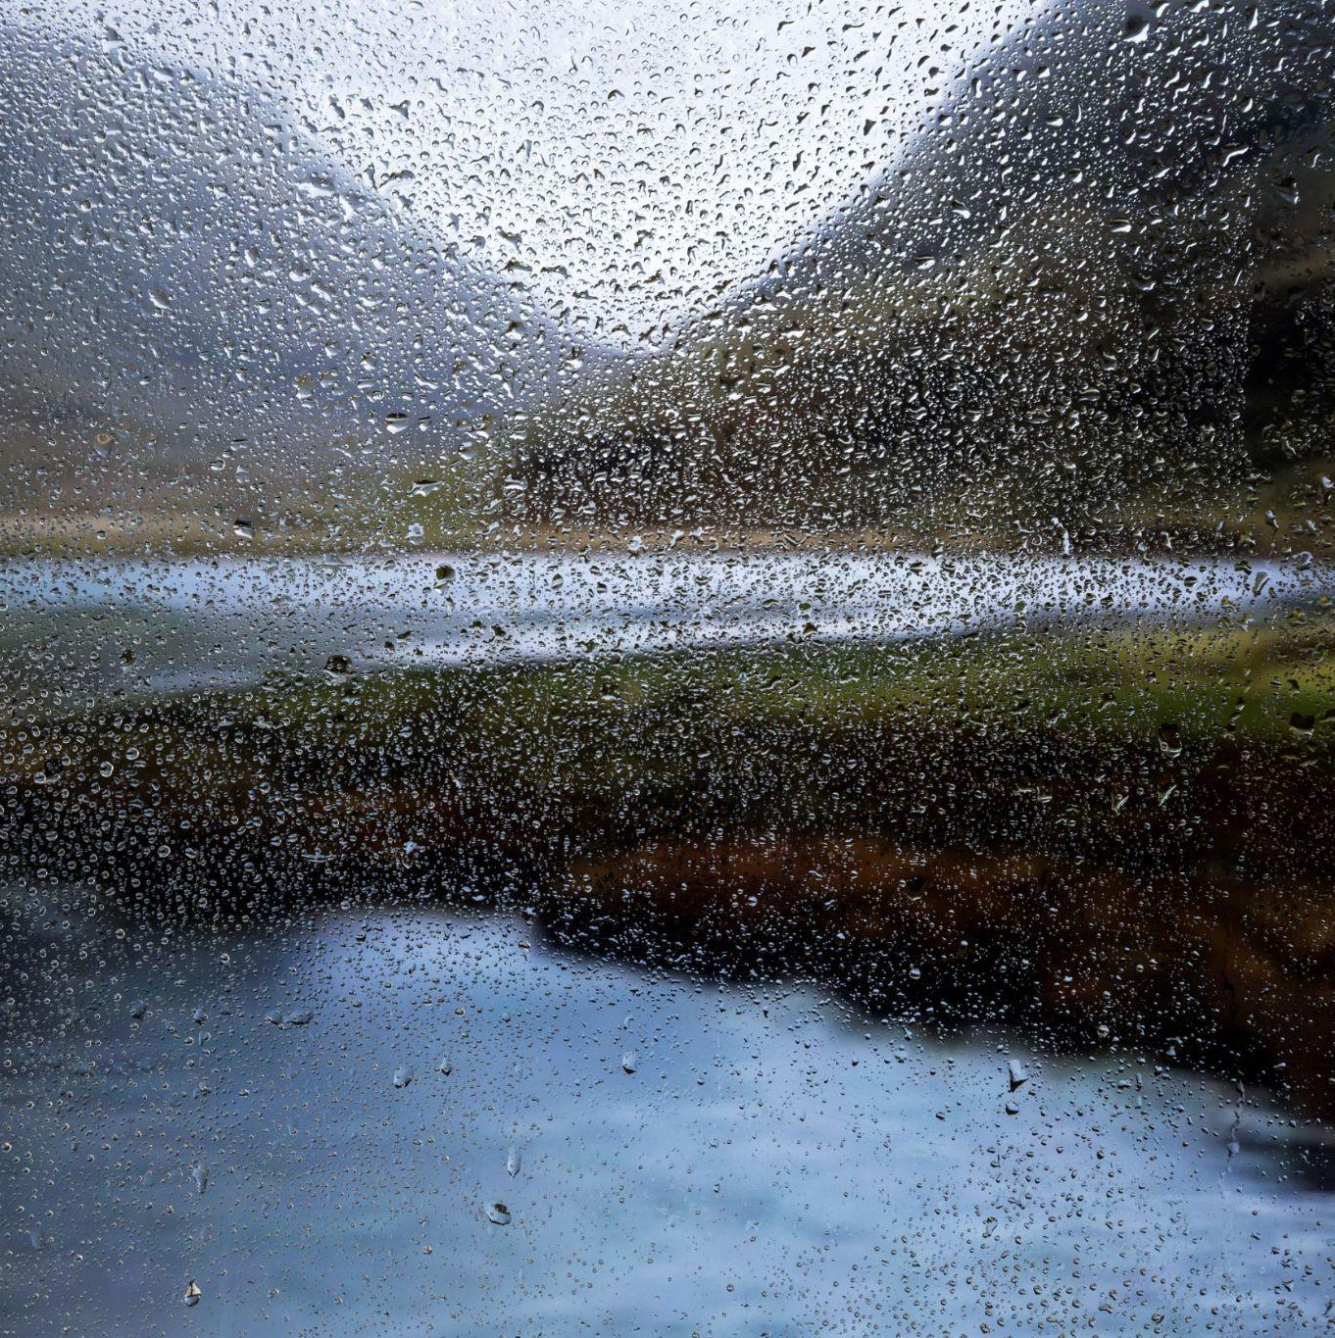
CREATE YOUR MINIATURE WATER CYCLE
STEP 1
Saturn is a gas giant with rings
STEP 2
Jupiter is the biggest planet in the Solar System
STEP 3
Despite being red, Mars is a cold place
STEP 4
Earth is the place where we live on
STEP 5
Venus has a beautiful name
STEP 6
Mercury is the closest planet to the Sun

Slide 28
WEATHER JOURNAL
TODAY’S DATE IS: 14/01/2022
Describe what the weather's like today in your city
WHAT IS TODAY’S TEMPERATURE?
Mars is actually a very cold place
HOW MUCH DID IT RAIN TODAY?
Saturn is a gas giant with rings

Slide 29
OUR TEAM
06
You can enter a subtitle here if you need it

Slide 30
METEOROLOGICAL TIMETABLE
JUPITER
MERCURY
Jupiter is the biggest planet of them all
It’s the closest planet to the Sun
VENUS
SATURN
Venus is the second planet from the Sun
It’s composed of hydrogen and helium

Slide 31



OUR TEAM
TIMMY JIMMY
JENNA DOE
SUSAN BONES
You can speak a bit about this person here
You can speak a bit about this person here
You can speak a bit about this person here

Slide 32
THANKS!
Do you have any questions?
youremail@freepik.com
+91 620 421 838
yourcompany.com
Please keep this slide for attribution

